Slide 1
The Math of Inverse Kinematics
Garrett Bowman, UF ECE

Slide 2
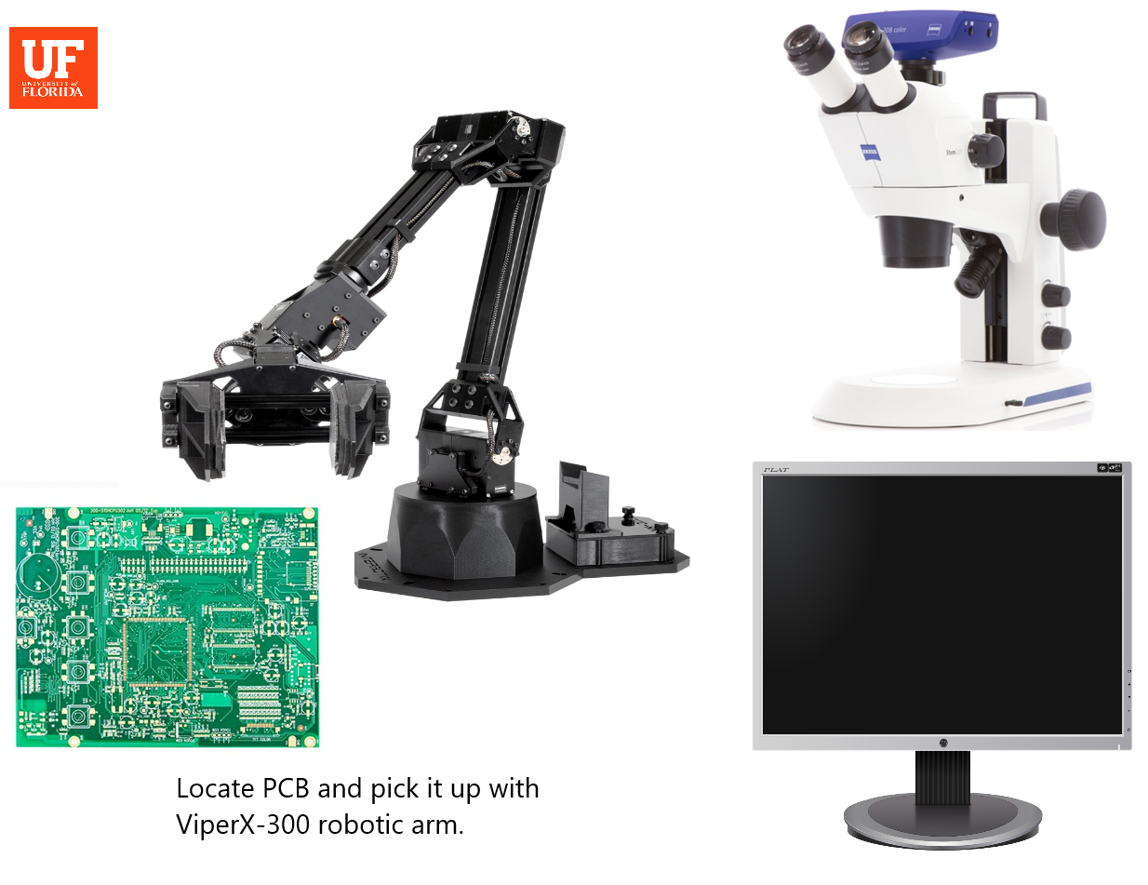
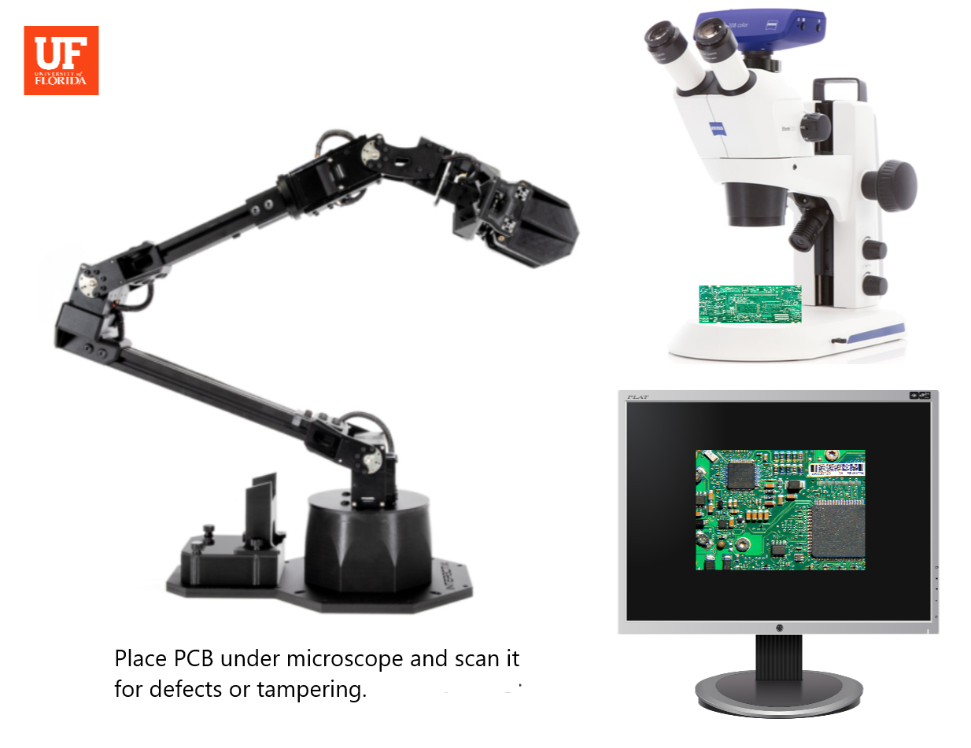
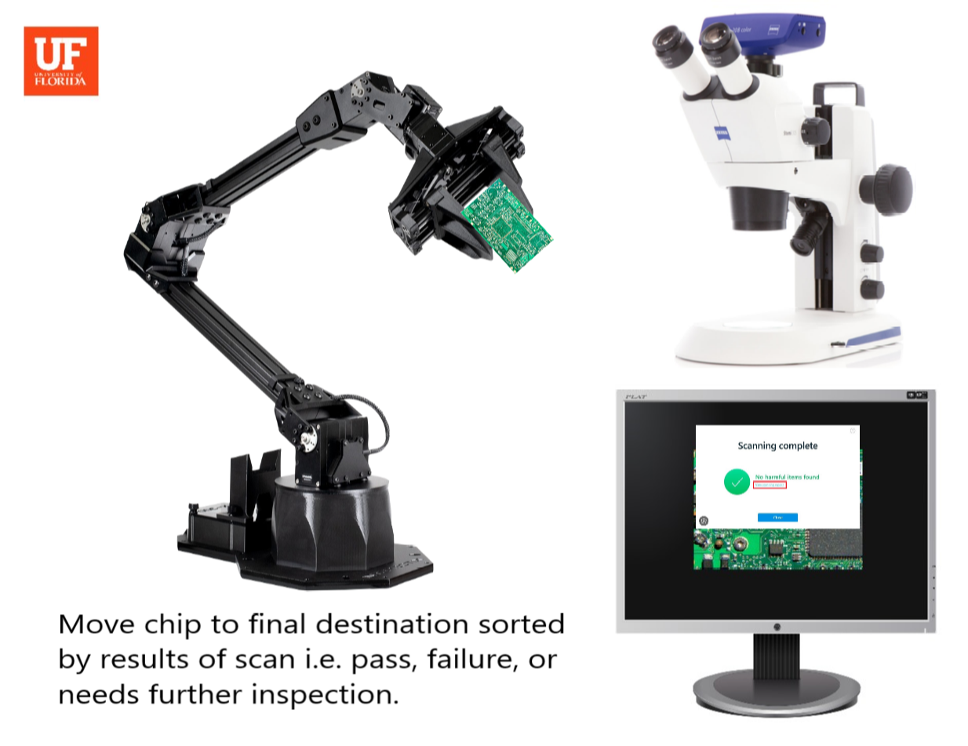
Automated PCB Inspection

Slide 3
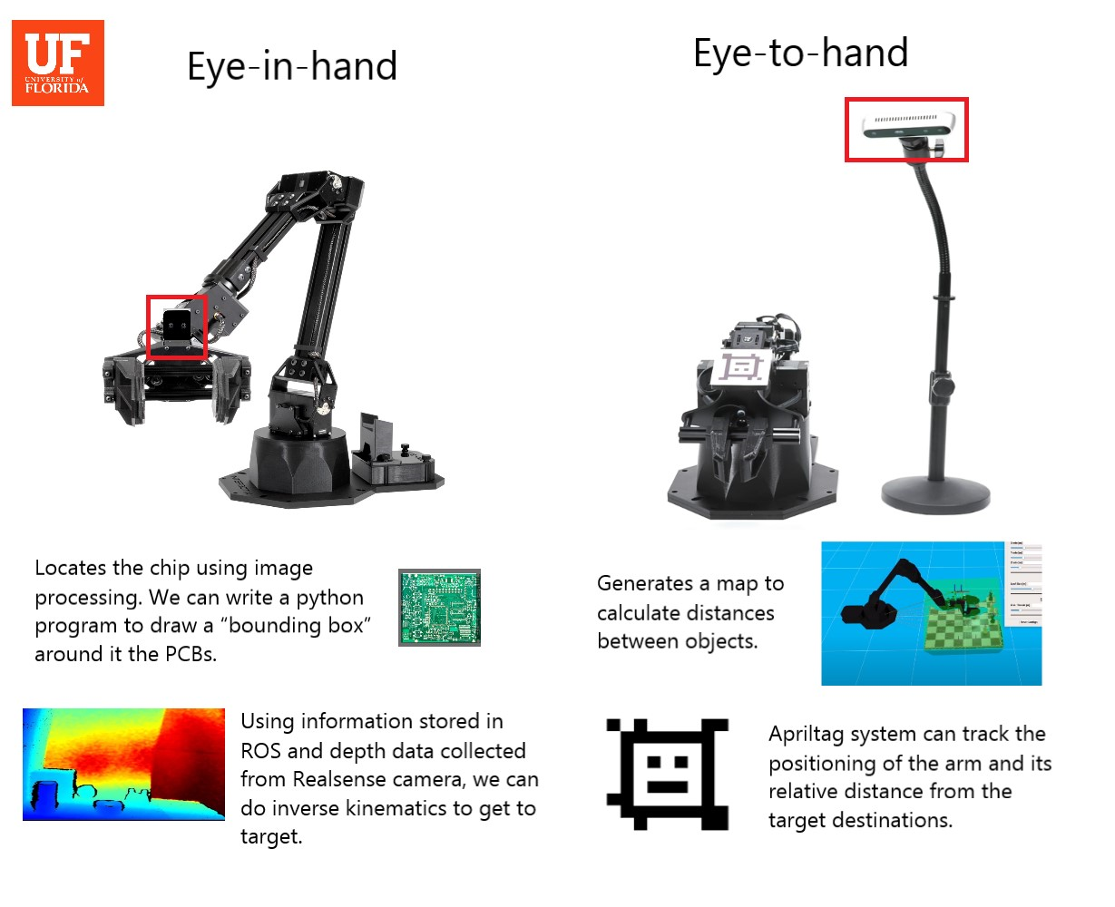

Slide 4
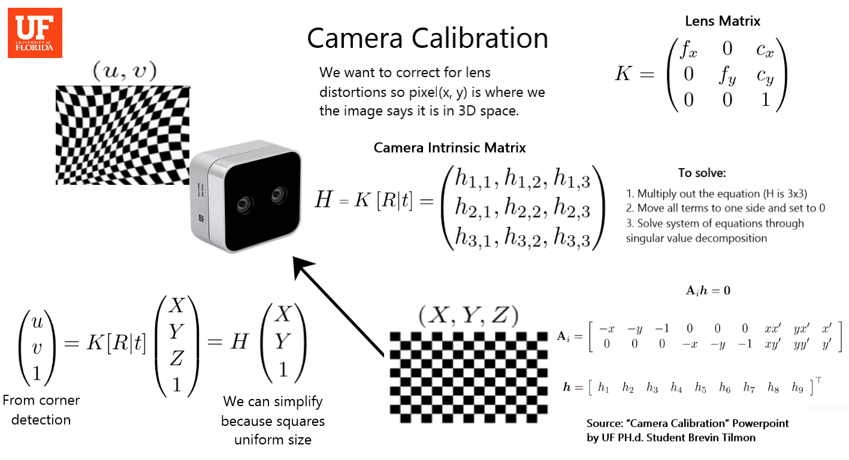

Slide 5
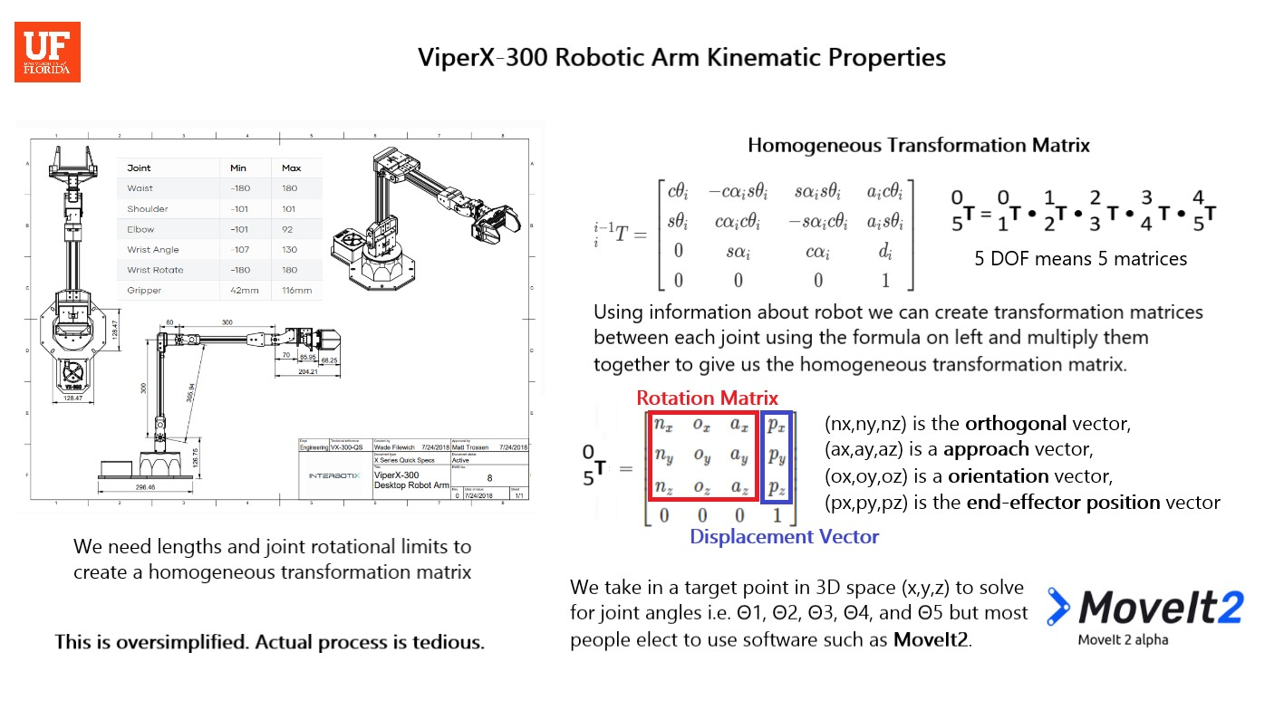

Slide 6

If we were going to calculate by hand..
We need to account for
Homogeneous transformation matrix
Camera intrinsic matrix (correction for lens distortions)
Eye-in-hand transform (transformation from camera to end of robot arm)
We multiply all 3 together to get the final transformation matrix in reference to base of robot.

Slide 7
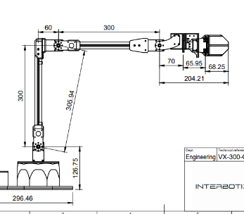
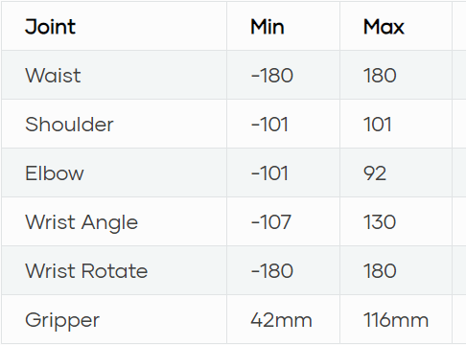
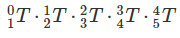
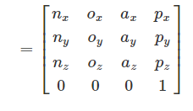
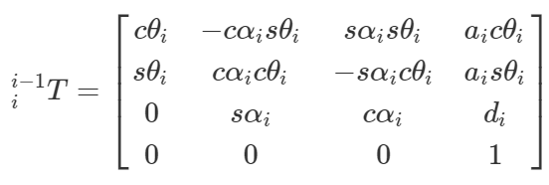
ViperX300 Robotic Arm Kinematic Properties
ViperX 300 has 5 degrees of freedom and distances are measured in the schematic
Use these values to calculate the homogeneous transformation matrix using equations on the right
₀⁵T =
Any position in the end effector frame can be mapped in the base frame
(nx,ny,nz) is the orthogonal vector, (ax,ay,az) is a approach vector, (ox,oy,oz) is a orientation vector, (px,py,pz) is the end-effector position vector
where sθi=sinθi, sαi=sinαi, cθi=cosθi, cαi=cosαi.
Source: G. -S. Huang, C. -K. Tung, H. -C. Lin and S. -H. Hsiao, "Inverse kinematics analysis trajectory planning for a robot arm," 2011 8th Asian Control Conference (ASCC), Kaohsiung, Taiwan, 2011, pp. 965-970.

Slide 8
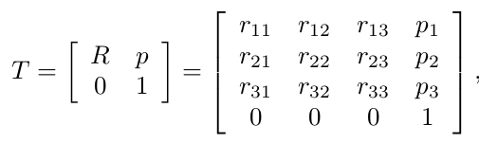
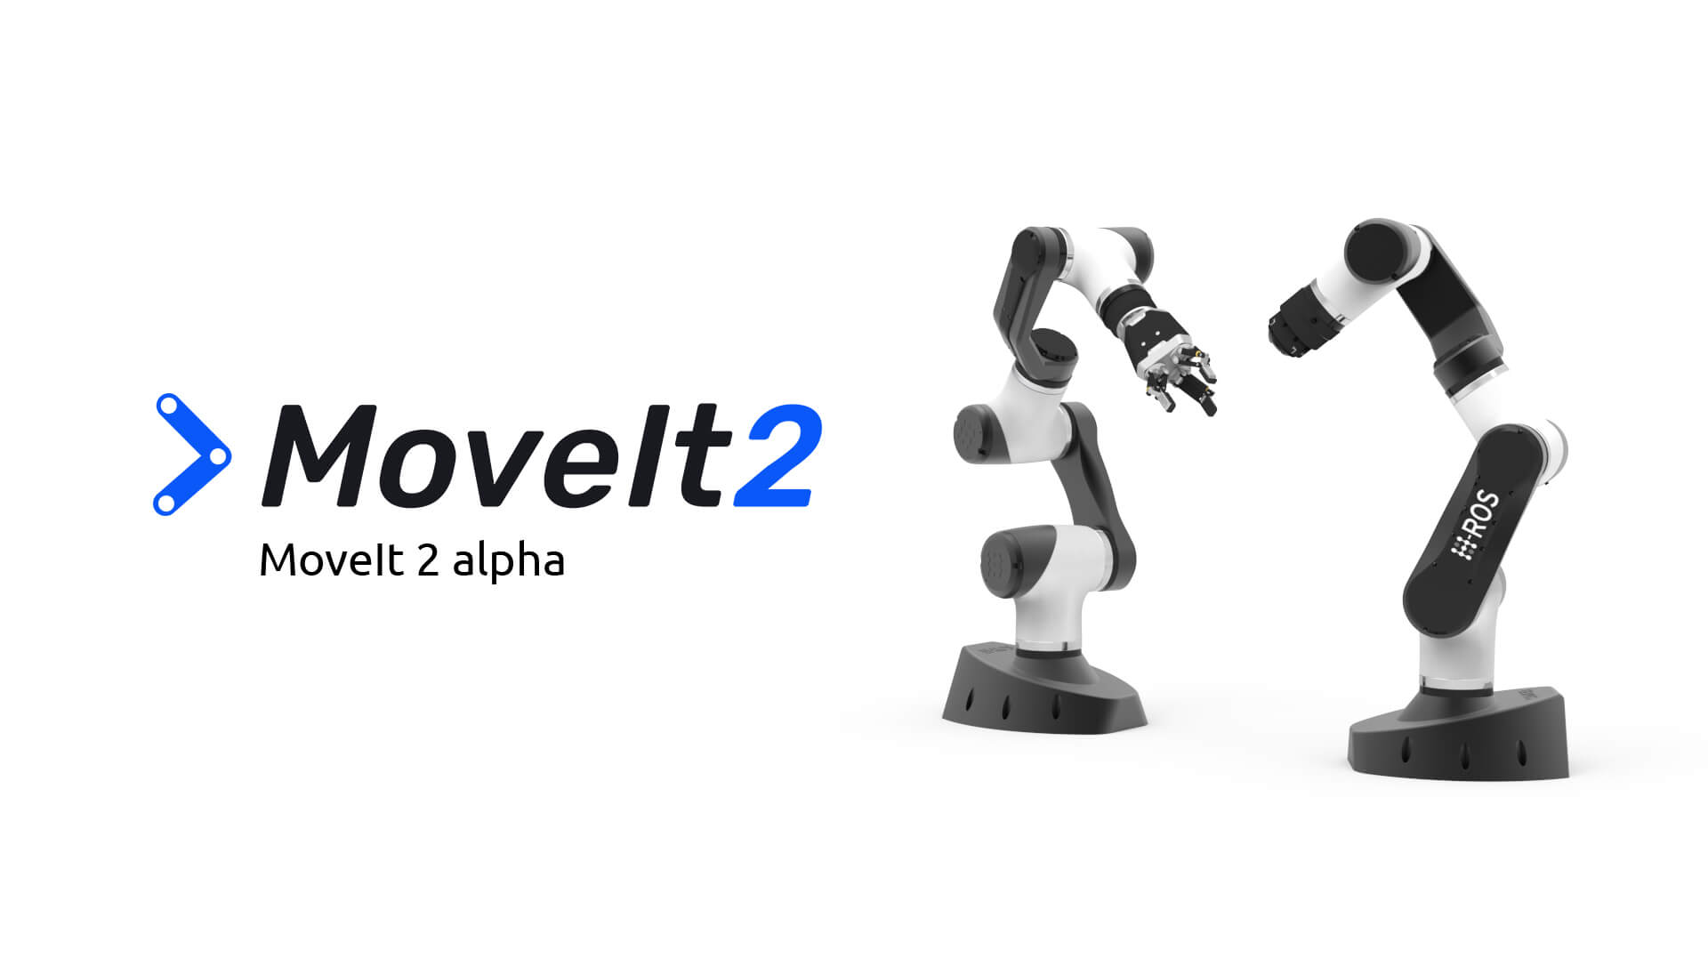
To find the inverse kinematics from homogeneous transformation matrix…
We are able to take in a desired point and and solve for joint angles i.e. Θ₁, Θ₂ , Θ₃ , Θ₄ , and Θ₅ by using the homogeneous transformation matrix, camera intrinsic matrix and the eye-in-hand transform multiplied together to get the final point in reference to base of robot.
It gets rather complex mathematically and beyond the scope of this short presentation but in the end we get 2 solutions, usually with one being clearly the better option.
This is typically done with software such as moveit to avoid the tedious matrix calculations.

Slide 9
end
Using information about robot we can create transformation matrices between each joint using formula on left and multiply them together to give us the homogeneous transformation matrix.
We take in a target point in 3D space (x,y,z) to solve for joint angles i.e. Θ1, Θ2, Θ3, Θ4, and Θ5 but most people elect to use software such as MoveIt2.

Slide 10
Trash
Forward kinematics: Mapping from joint space to cartesian space
F(Q)=W
and training a neural network based on images of PCBs.

Slide 11
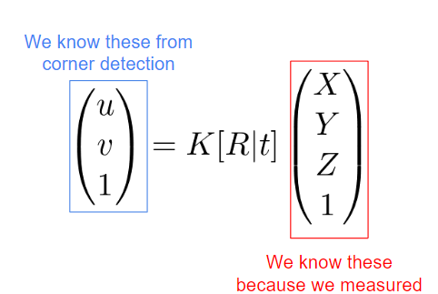
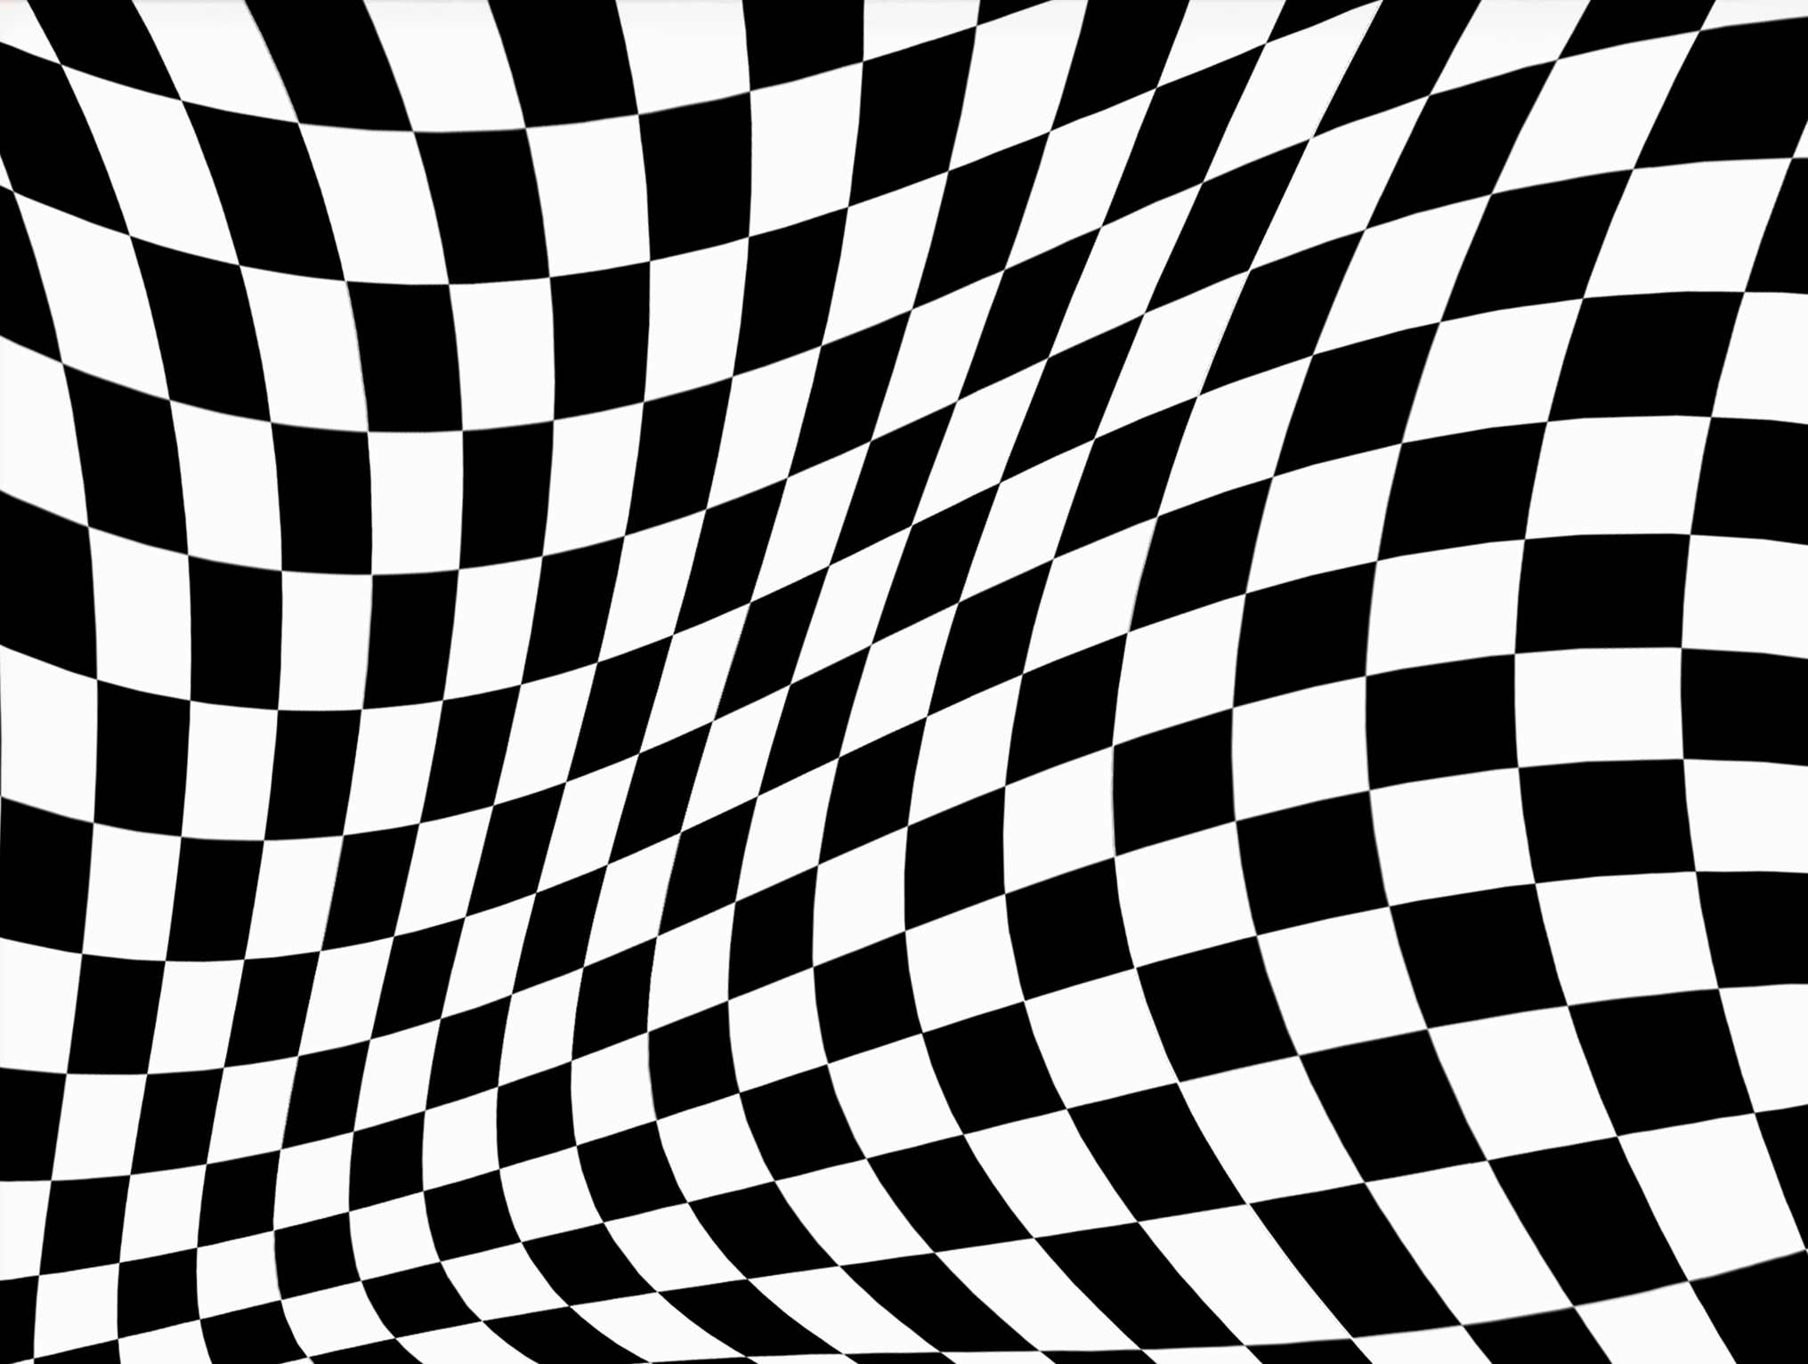
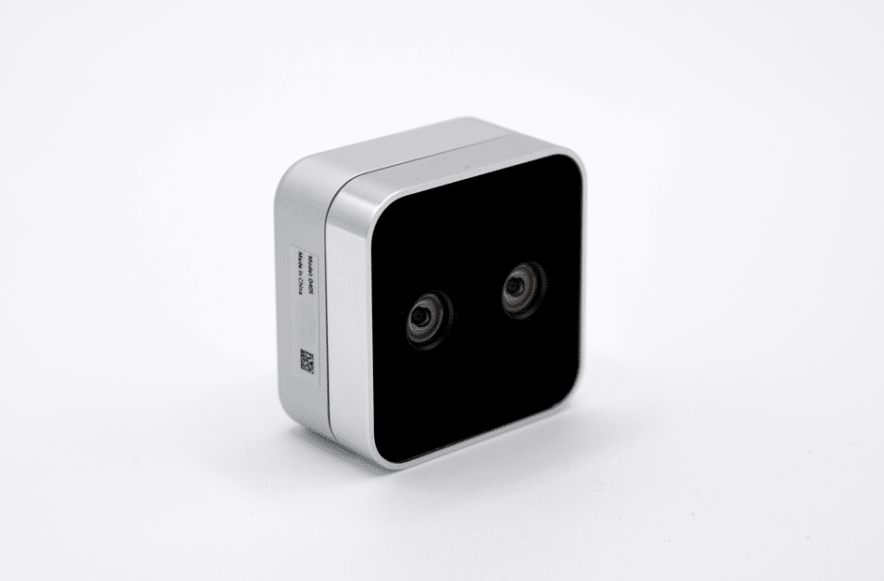
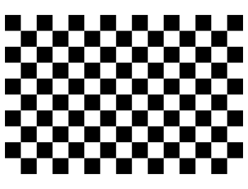
Eye-in-hand calibration
We are able to get the object’s position from the RealSense data by comparing the data we get from the camera to an object of known values to get a Camera Intrinsic Matrix in order to correct for the distortion. A checkerboard is commonly used for this.
This can be further refined but we are solving for H =K[R|T] which tells us how the camera is distorting the 3D points.
We also need the Eye-In-Hand Calibration Matrix which is just the transformation from the camera to the end effector.
Source: “Camera Calibration” Powerpoint by UF PH.d. Student Brevin Tilmon

Slide 12
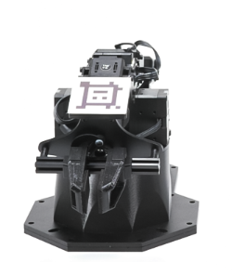
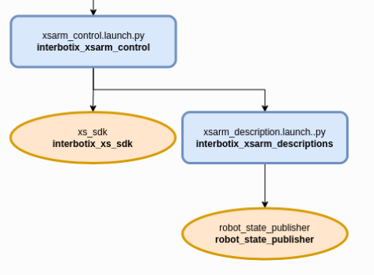
Perception of arm position
The Interbotix ROS Arm Vision Kit has an Apriltag system that can track the positioning of the arm and its relative distance from the target destinations.
The Eye-in-hand method will have to make use of the information stored in ROS to accurately perceive the position.
The sensors in the robot work with move_group and robot_state_publisher to publish the robot positional data to joint_states topic.

Slide 13
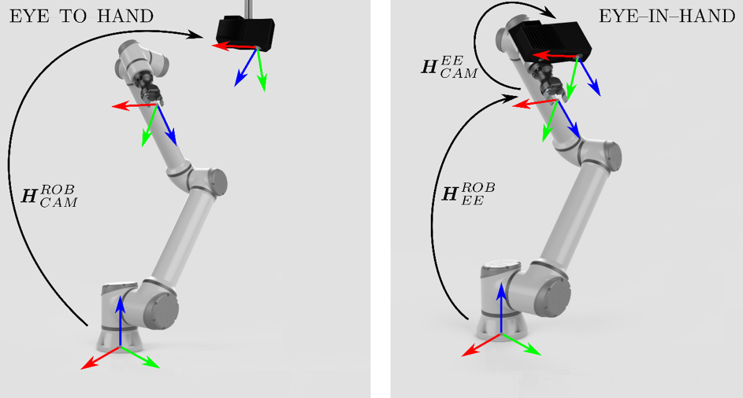
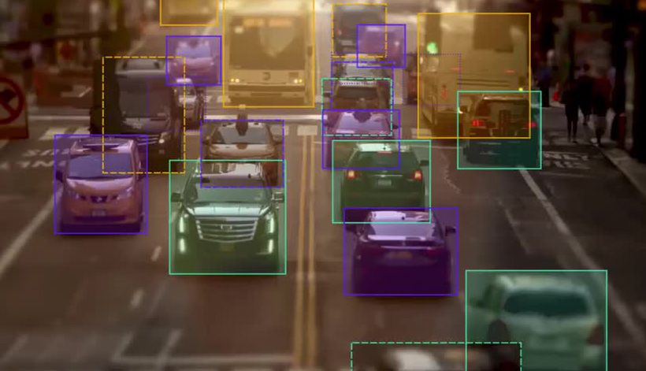
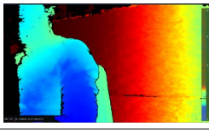
Eye-to-hand vs Eye-in-hand
Eye-to-hand generates a map to calculate distances between objects.
Eye-in-hand locates the chip using image processing . We can write a python program to draw a “bounding box” around it the PCBs.
The RealSense 405 camera has depth detection capabilities. The average distance located within the bounding box is distance from camera.
ROS2 stores joint positional data on joint_states topic. We can use this with our camera distance calculation to determine cartesian coordinates of the PCB.

Slide 14
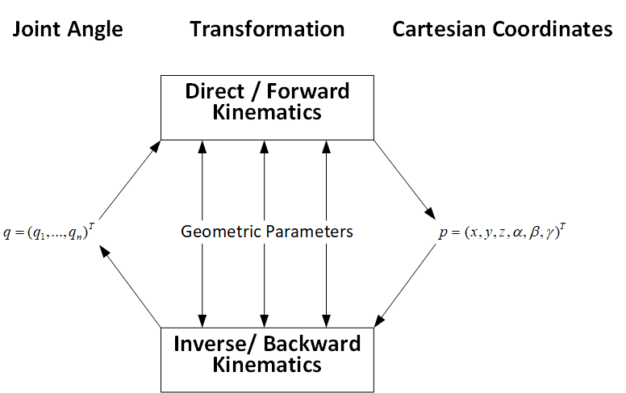
Forward vs. Inverse
Inverse kinematics: Mapping from cartesian space to joint space
Q=F⁻¹(W)
It is critical we get good reading of Cartesian Space W to be able to accurately translate it to joint space.
The more degrees of freedom a robot has i.e. joints, the more complex the calculation.

